Slide 1
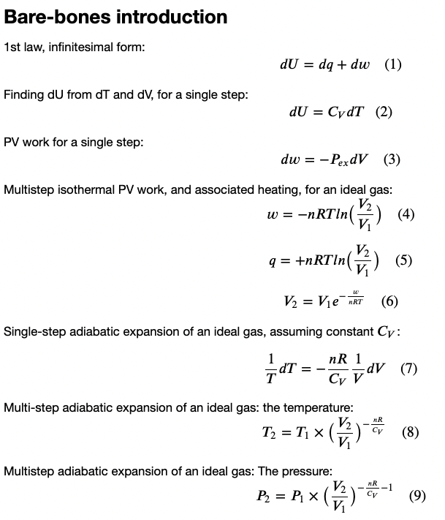
Agenda for today
Heat, work, and the 1st Law
Explore how that relates to the behavior of gases as they expand & contract

Slide 2
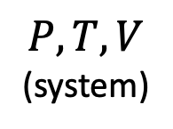

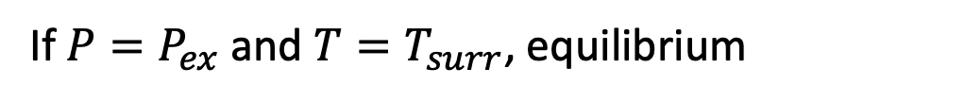

How thermodynamics frames the idea of heat and work
If $P=P_{ex}$ and $T=T_{surr}$, equilibrium
$$P_{ex}$$
$$T_{surr}$$
$$P,T,V$$
(system)

Slide 3
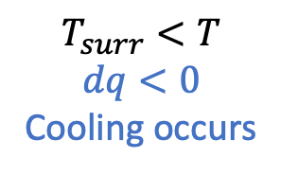
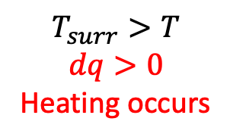
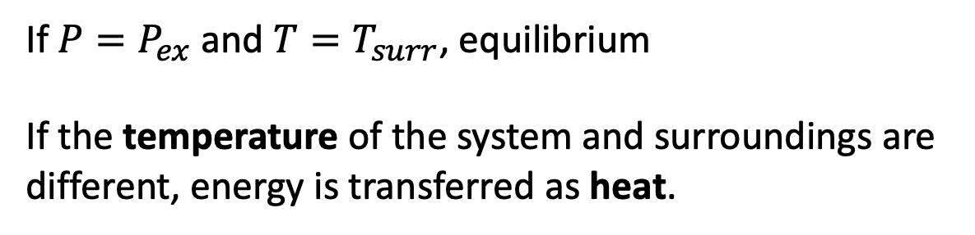
How thermodynamics frames the idea of heat and work
If $P=P_{ex}$ and $T=T_{surr}$, equilibrium
If the temperature of the system and surroundings are different, energy is transferred as heat.
$$P_{ex}$$
$$T_{surr}<T$$
$$dq<0$$
Cooling occurs
$$T_{surr}>T$$
$$dq>0$$
Heating occurs
$$T_{surr}$$
$$P,T,V$$
(system)
surroundings
T
(system)

Slide 4
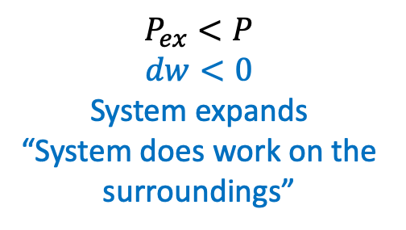
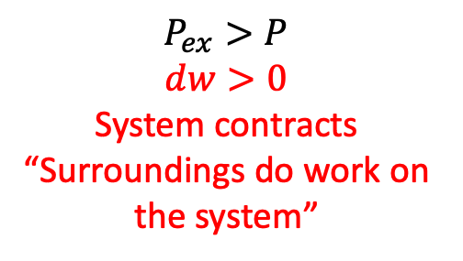

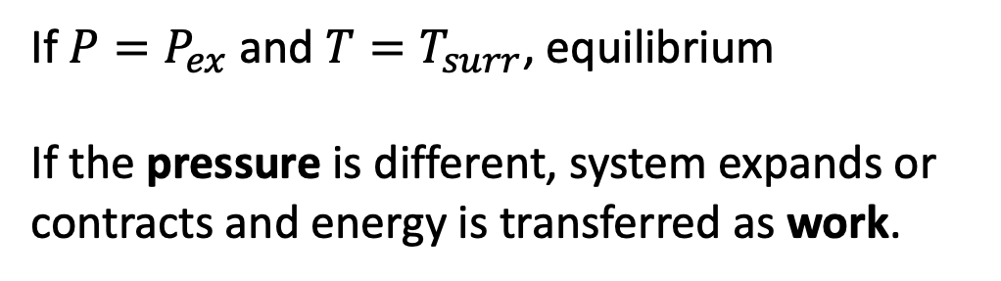
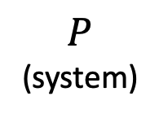
How thermodynamics frames the idea of heat and work
If $P=P_{ex}$ and $T=T_{surr}$, equilibrium
If the pressure is different, system expands or contracts and energy is transferred as work.
$$P_{ex}$$
$$P_{ex}<P$$
$$dw<0$$
System expands
“System does work on the surroundings”
$$P_{ex}>P$$
$$dw>0$$
System contracts
“Surroundings do work on the system”
$$T_{surr}$$
$$P,T,V$$
(system)
surroundings
$$P$$
(system)
$$P$$
(system)

Slide 5

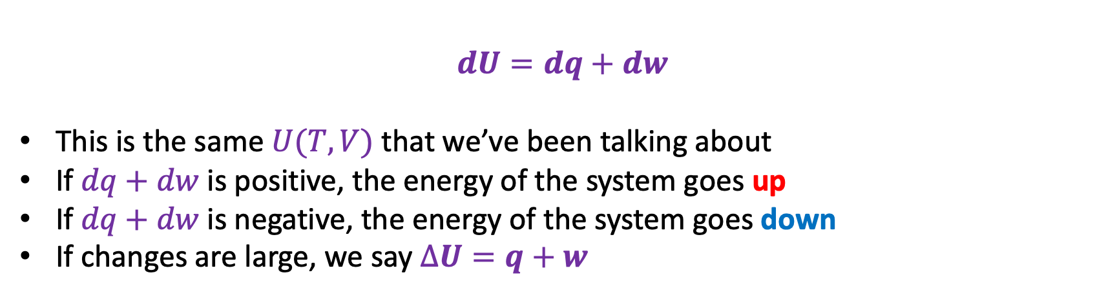
1st law, infinitesimal form
$$dU=dq+dw$$
This is the same $U(T,V)$ that we’ve been talking about
If $dq+dw$ is positive, the energy of the system goes up
If $dq+dw$ is negative, the energy of the system goes down
If changes are large, we say $∆U=q+w$
$$U(T,V)$$
V
T

Slide 6
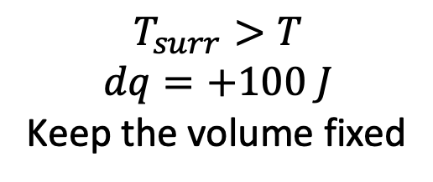
Applying the 1st law when heating (or cooling) a diatomic ideal gas
$$T_{surr}>T$$
$$dq=+100 J$$
Keep the volume fixed
$$U(T,V)$$
V
This looks like isochoric heating
T
T
(system)

Slide 7
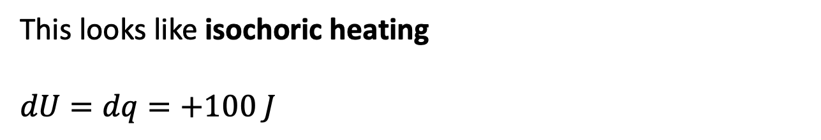
Applying the 1st law when heating (or cooling) a diatomic ideal gas
$$T_{surr}>T$$
$$dq=+100 J$$
Keep the volume fixed
$$U(T,V)$$
V
This looks like isochoric heating
$$dU=dq=+100 J$$
T
T
(system)

Slide 8
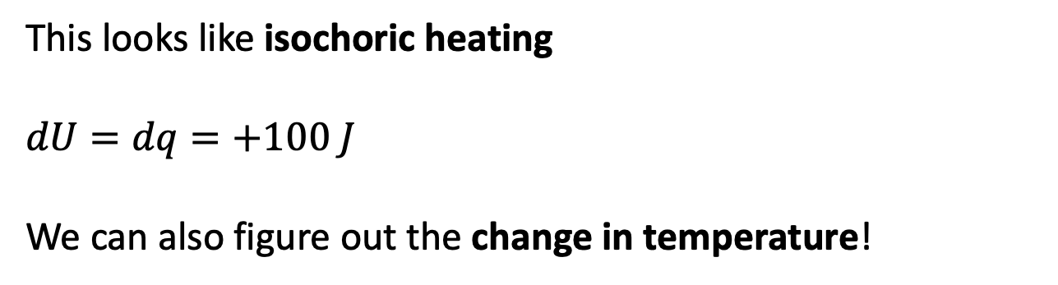
Applying the 1st law when heating (or cooling) a diatomic ideal gas
$$T_{surr}>T$$
$$dq=+100 J$$
Keep the volume fixed
$$U(T,V)$$
V
This looks like isochoric heating
$$dU=dq=+100 J$$
We can also figure out the change in temperature!
T
T
(system)

Slide 9
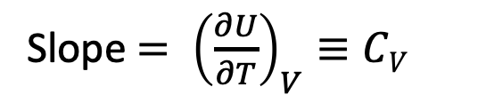

Digression: Finding dU from dT and dV, for a single step
“Slope equals rise/run”
$$U(T,V)$$
Slope $= {\left(\frac{∂U}{∂T}\right)}_{V}≡CV$
V
T
dT

Slide 10
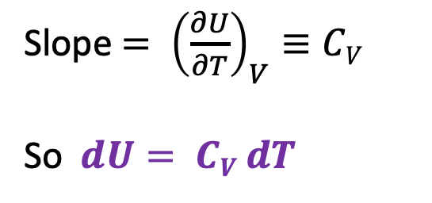
Digression: Finding dU from dT and dV, for a single step
$$U(T,V)$$
Slope $= {\left(\frac{∂U}{∂T}\right)}_{V}≡CV$
So $dU= CV dT$
V
T
dT
“Rise equals slope x run”

Slide 11
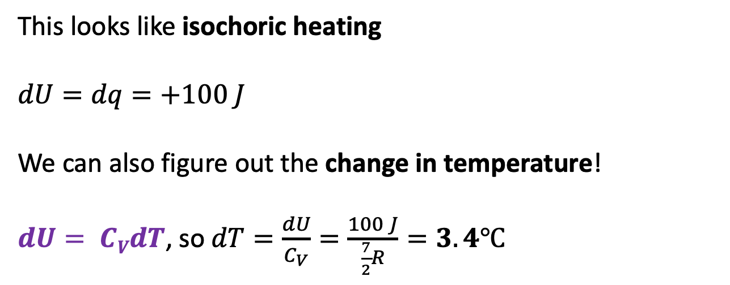

Applying the 1st law when heating (or cooling) a diatomic ideal gas
$$T_{surr}>T$$
$$dq=+100 J$$
Keep the volume fixed
$$U(T,V)$$
V
This looks like isochoric heating
$$dU=dq=+100 J$$
We can also figure out the change in temperature!
$dU= CVdT$, so $dT=\frac{dU}{C_{V}}=\frac{100 J}{\frac{7}{2}R}=3.4℃$
T
T
(system)
($C_{V}$ in the classical limit)

Slide 12


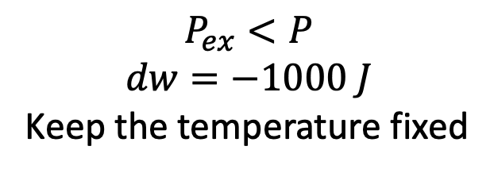
Applying the 1st law when expanding (or contracting) a diatomic ideal gas
$$P_{ex}<P$$
$$dw=−1000 J$$
Keep the temperature fixed
$$U(T,V)$$
V
This looks like isothermal expansion
$$dw=−1000 J$$
$$∆U=0$$
T
$$P$$
(system)

Slide 13
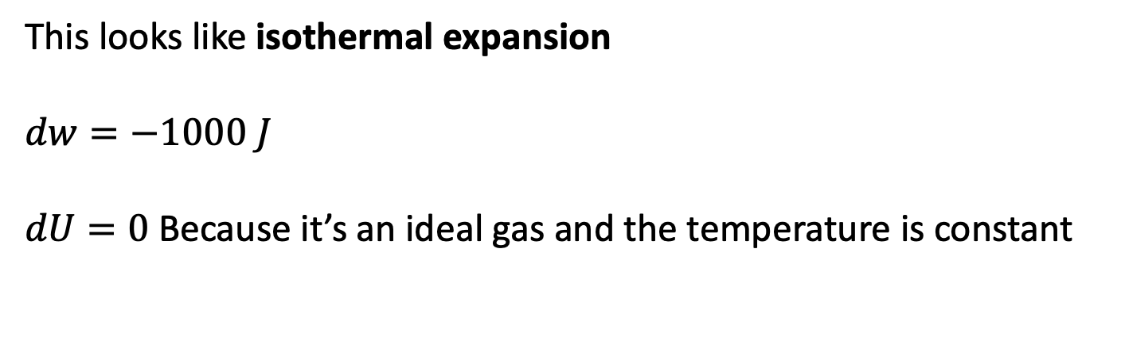
Applying the 1st law when expanding (or contracting) a diatomic ideal gas
$$P_{ex}<P$$
$$dw=−1000 J$$
Keep the temperature fixed
$$U(T,V)$$
V
This looks like isothermal expansion
$$dw=−1000 J$$
$dU=0$ Because it’s an ideal gas and the temperature is constant
T
$$P$$
(system)

Slide 14
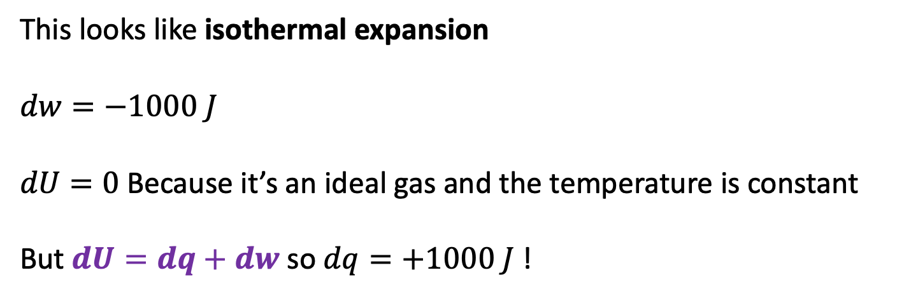
Applying the 1st law when expanding (or contracting) a diatomic ideal gas
$$P_{ex}<P$$
$$dw=−1000 J$$
Keep the temperature fixed
$$U(T,V)$$
V
This looks like isothermal expansion
$$dw=−1000 J$$
$dU=0$ Because it’s an ideal gas and the temperature is constant
But $dU=dq+dw$ so $dq=+1000 J$ !
T
$$P$$
(system)

Slide 15

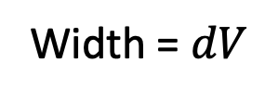

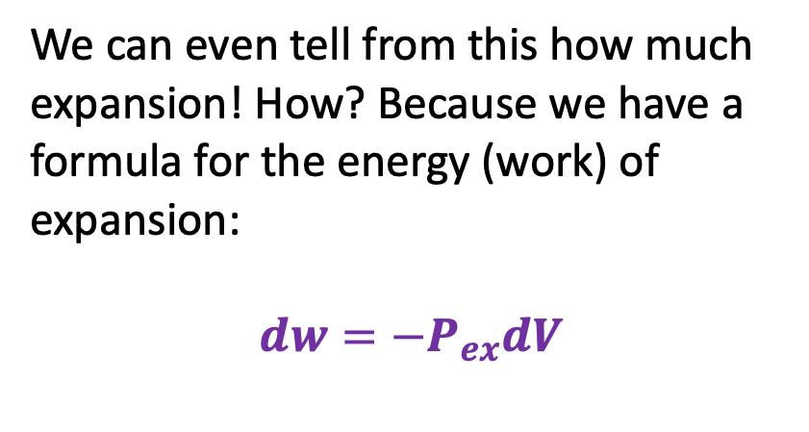

PV work, single step
$$P_{ex}<P$$
$$dw=−1000 J$$
Keep the temperature fixed
$$U(T,V)$$
V
We can even tell from this how much expansion! How? Because we have a formula for the energy (work) of expansion:
$$dw=−P_{ex}dV$$
T
$$P$$
(system)
$$P_{ex}$$
$$P_{Ideal}=nRT/V$$
Width = $dV$
$$V$$

Slide 16






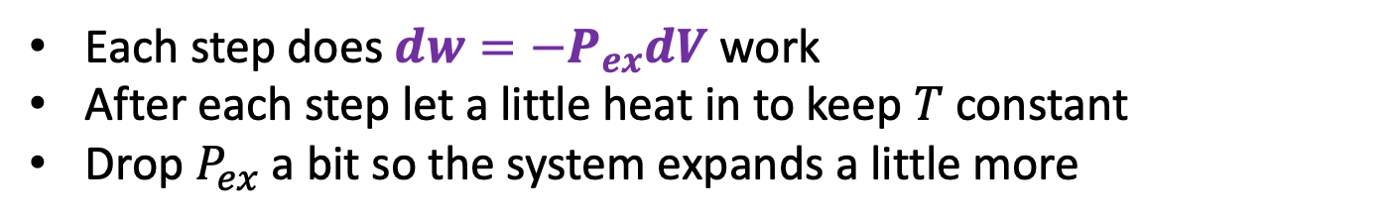


Multistep isothermal expansion/contraction of an ideal gas
Each step does $dw=−P_{ex}dV$ work
After each step let a little heat in to keep $T$constant
Drop $P_{ex}$ a bit so the system expands a little more
$$P_{ex}$$
$$P_{ex}$$
$$P_{2},V_{2}$$
$$P_{1},V_{1}$$
$$P_{ex}$$
$$P_{Ideal}=nRT/V$$
$$V_{1}$$
$$V_{2}$$

Slide 17
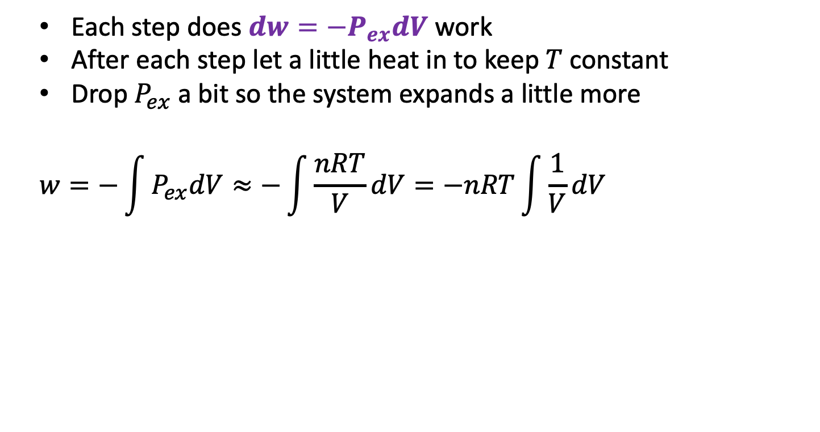
Multistep isothermal expansion/contraction of an ideal gas
Each step does $dw=−P_{ex}dV$ work
After each step let a little heat in to keep $T$constant
Drop $P_{ex}$ a bit so the system expands a little more
$$w=−\int{P_{ex}dV≈−\int{\frac{nRT}{V}dV}=−nRT\int{\frac{1}{V}dV}}$$
$$P_{ex}$$
$$P_{ex}$$
$$P_{2},V_{2}$$
$$P_{1},V_{1}$$
$$P_{ex}$$
$$P_{Ideal}=nRT/V$$
$$V_{1}$$
$$V_{2}$$

Slide 18
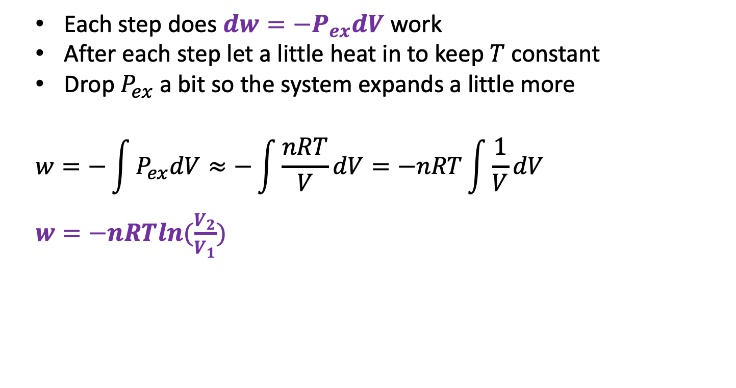
Multistep isothermal expansion/contraction of an ideal gas
Each step does $dw=−P_{ex}dV$ work
After each step let a little heat in to keep $T$constant
Drop $P_{ex}$ a bit so the system expands a little more
$$w=−\int{P_{ex}dV≈−\int{\frac{nRT}{V}dV}=−nRT\int{\frac{1}{V}dV}}$$
$w=−nRTln(\frac{V_{2}}{V_{1}})$
$$P_{ex}$$
$$P_{ex}$$
$$P_{2},V_{2}$$
$$P_{1},V_{1}$$
$$P_{ex}$$
$$P_{Ideal}=nRT/V$$
$$V_{1}$$
$$V_{2}$$

Slide 19
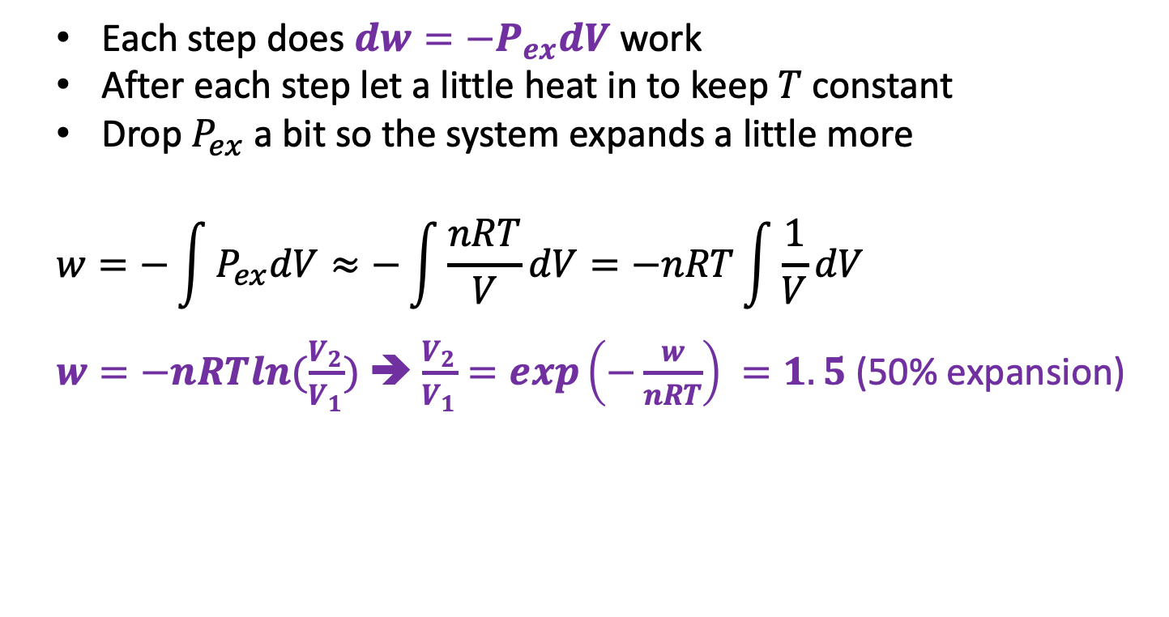
Multistep isothermal expansion/contraction of an ideal gas
Each step does $dw=−P_{ex}dV$ work
After each step let a little heat in to keep $T$constant
Drop $P_{ex}$ a bit so the system expands a little more
$$w=−\int{P_{ex}dV≈−\int{\frac{nRT}{V}dV}=−nRT\int{\frac{1}{V}dV}}$$
$w=−nRTln(\frac{V_{2}}{V_{1}})$ ➔ $\frac{V_{2}}{V_{1}}=exp\left(−\frac{w}{nRT}\right) =1.5$ (50% expansion)
$$P_{ex}$$
$$P_{ex}$$
$$P_{2},V_{2}$$
$$P_{1},V_{1}$$
$$P_{ex}$$
$$P_{Ideal}=nRT/V$$
$$V_{1}$$
$$V_{2}$$

Slide 20

Multistep isothermal expansion/contraction of an ideal gas
We also know how much heat went in!
$$∆U=q+w$$
$w=−nRTln\left(\frac{V_{2}}{V_{1}}\right)$ (negative when expanding)
$q=+nRTln\left(\frac{V_{2}}{V_{1}}\right)$ (positive when expanding)
$$P_{ex}$$
$$P_{ex}$$
$$P_{2},V_{2}$$
$$P_{1},V_{1}$$
$$P_{ex}$$
$$P_{Ideal}=nRT/V$$
$$V_{1}$$
$$V_{2}$$

Slide 21


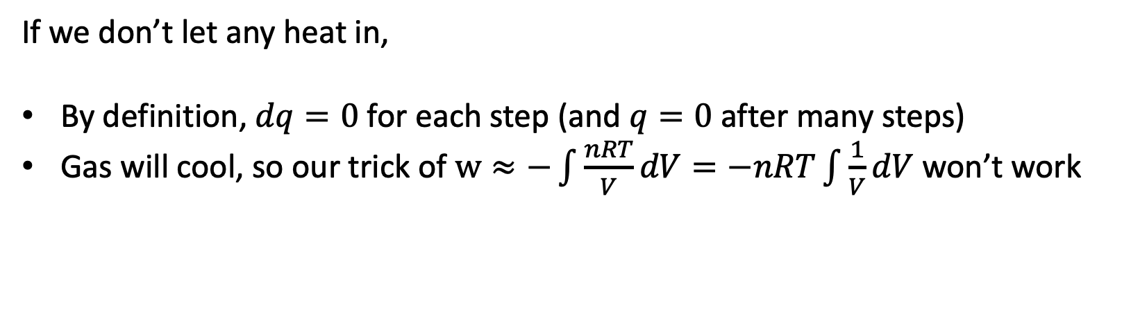
Adiabatic expansion of an ideal gas
$$P_{ex}$$
$$V$$
If we don’t let any heat in,
By definition, $dq=0$ for each step (and $q=0$ after many steps)
Gas will cool, so our trick of $w≈−\int{\frac{nRT}{V}dV}=−nRT\int{\frac{1}{V}dV}$ won’t work

Slide 22

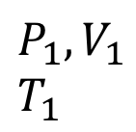
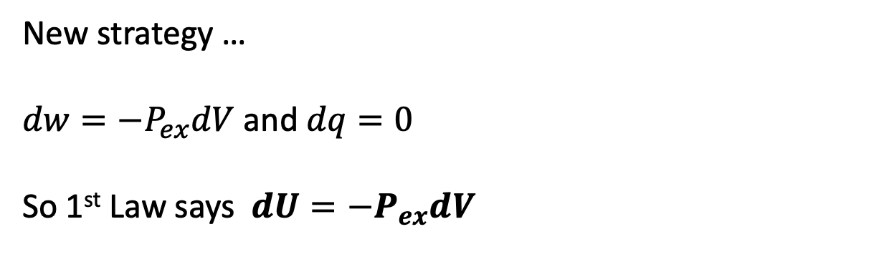






Single-step adiabatic expansion of an ideal gas
New strategy …
$dw=−P_{ex}dV$ and $dq=0$
So 1st Law says $dU=−P_{ex}dV$
$$U(T,V)$$
V
$$P_{ex}$$
T
$$P_{ex}$$
$$P_{2},V_{2}$$
$$T_{2}$$
$$P_{1},V_{1}$$
$$T_{1}$$
$$P_{ex}$$
No heat going in/out
Temperature is going down
$$dV$$
$$V$$

Slide 23
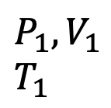
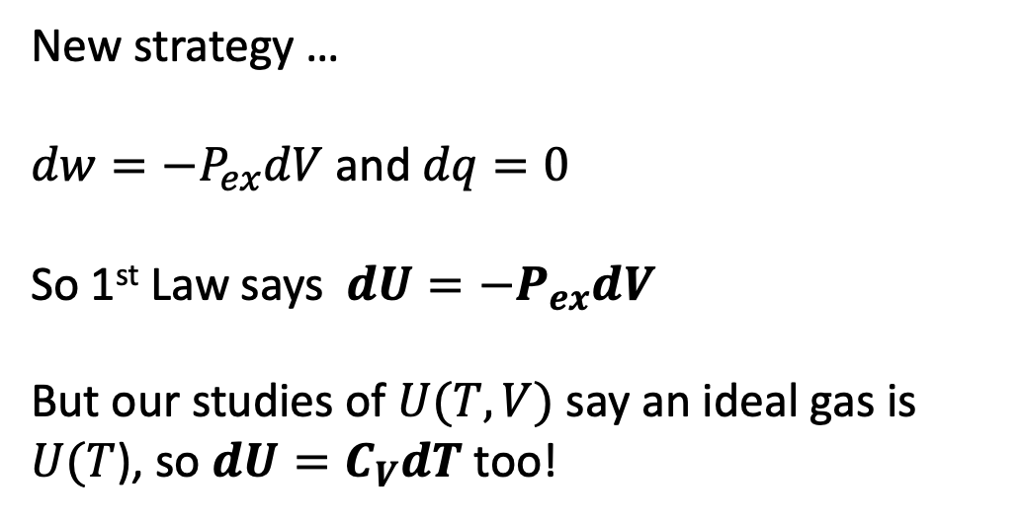

Single-step adiabatic expansion of an ideal gas
New strategy …
$dw=−P_{ex}dV$ and $dq=0$
So 1st Law says $dU=−P_{ex}dV$
But our studies of $U(T,V)$ say an ideal gas is $U(T$), so $dU=C_{V}dT$ too!
$$U(T,V)$$
V
$$P_{ex}$$
T
$$P_{ex}$$
$$P_{2},V_{2}$$
$$T_{2}$$
$$P_{1},V_{1}$$
$$T_{1}$$
$$P_{ex}$$
No heat going in/out
Temperature is going down
$$dV$$
$$V$$

Slide 24

Single-step adiabatic expansion of an ideal gas
New strategy …
$dw=−P_{ex}dV$ and $dq=0$
So 1st Law says $dU=−P_{ex}dV$
But our studies of $U(T,V)$ say an ideal gas is $U(T$), so $dU=C_{V}dT$ too!
Put them together!
$$−P_{ex}dV=C_{V}dT$$
Call it an ideal gas!
$$−\frac{nRT}{V}dV=C_{V}dT$$
$$U(T,V)$$
V
$$P_{ex}$$
T
$$P_{ex}$$
$$P_{2},V_{2}$$
$$T_{2}$$
$$P_{1},V_{1}$$
$$T_{1}$$
$$P_{ex}$$
No heat going in/out
Temperature is going down
$$dV$$
$$V$$

Slide 25

Single-step adiabatic expansion of an ideal gas
Solve for this:
$$\frac{1}{T}dT=…$$
$$U(T,V)$$
V
$$P_{ex}$$
T
$$P_{ex}$$
$$P_{2},V_{2}$$
$$T_{2}$$
$$P_{1},V_{1}$$
$$T_{1}$$
$$P_{ex}$$
No heat going in/out
Temperature is going down
$$dV$$
$$V$$

Slide 26

Single-step adiabatic expansion of an ideal gas
Solve for this:
$$\frac{1}{T}dT=−\frac{nR}{C_{V}} \frac{1}{V}dV$$
$$U(T,V)$$
V
$$P_{ex}$$
T
$$P_{ex}$$
$$P_{2},V_{2}$$
$$T_{2}$$
$$P_{1},V_{1}$$
$$T_{1}$$
$$P_{ex}$$
No heat going in/out
Temperature is going down
$$dV$$
$$V$$

Slide 27

Single-step adiabatic expansion of an ideal gas
Some interpretation …
$$\frac{1}{T}dT=−\frac{nR}{C_{V}} \frac{1}{V}dV$$
$\frac{1}{V}dV$ is the fractional change in volume. Multiply that by $−\frac{nR}{C_{V}}$ to get the fractional change in temperature! Works with % too.
$$U(T,V)$$
V
$$P_{ex}$$
T
$$P_{ex}$$
$$P_{2},V_{2}$$
$$T_{2}$$
$$P_{1},V_{1}$$
$$T_{1}$$
$$P_{ex}$$
No heat going in/out
Temperature is going down
$$dV$$
$$V$$

